Slide 1
Looking for Games: A Board Game Utility
James Fitzpatrick, Stuart Long, Frank Singel

Slide 2
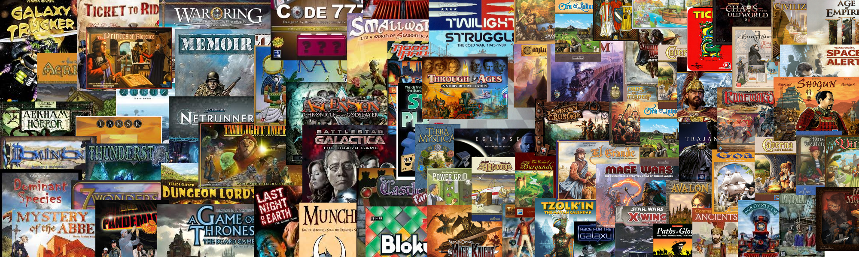
Introduction
Over 60,000 unique board games currently being made

Slide 3
Project Purpose
Currently no utility for providing comprehensive services to board gamers
Current sites dedicated to board games are ugly and not useful
LFG will allows players to organize their board game collection, view data trends, and connect with fellow players
The project will focus on data collection and analysis on users' board game collection

Slide 4
Application
This project will provide an online database through which users will be able to:
Publicly list their board game collection
List what games they're looking to play
Find other users looking to play similar games
Review and browse reviews of specific games
View data analyses on different board games and their collection
Get recommendations for games to play

Slide 5



Project Management
Team Roles
James
Database development
Data Trends/Suggestions
Stuart
Project Manager
Front End/Back End Connection
Frank
Facebook Integration
User Experience
Github - Source control of choice
Trello - Method of tracking tasks and bugs

Slide 6








TECHNOLOGY
Python
Javascript
Django
Bootstrap
Facebook
MySQL
Github
Trello

Slide 7
Challenges
Feature Creep
A lot of possible features to add
Storage Issues
Uncertain Storage Requirements
Content versus Speed
Game Suggestions
Complexity of Machine Learning
Which data is important?
Small Sample Sizes
Aesthetics
Content vs Visual Appeal vs Speed

Slide 8
Questions?
Thank you for your time!

